Slide 1
Locally Converting Plastic to Oil
Native Village of Gakona, Demonstration Project
By Erin Smith

Slide 2
Introduction
Imagine if you were able to convert unwanted plastic into usable oil! It has been made possible by new age Japanese technology, and the Native Village of Gakona had the opportunity to explore this concept through the “Community Environmental Demonstration Project Grant” from Zender Environmental.

Slide 3
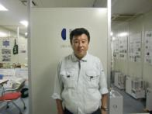
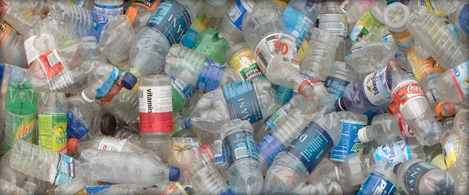
History
Discovering the Plastic-to-Oil machine
The Japanese inventor Akinori Ito
World Wide Idea turned reality
The Alaska Movement: Chena & Gakona

Slide 4
A Precious Fossil Fuel
US Energy Consumption in 2012
Top 10 Petroleum Consumers

Slide 5
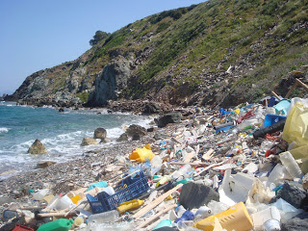
The Project
The CEDP grant goals
The 9 Different Village Demonstrations
Feedback

Slide 6
Presenting to Lisa Murkowski Representatives
Concept was presented to Alaska’s State Senator in Summer 2012

Slide 7
Native Village of Chickaloon Demonstration
Tribal & community members at the Elder’s Luncheon

Slide 8
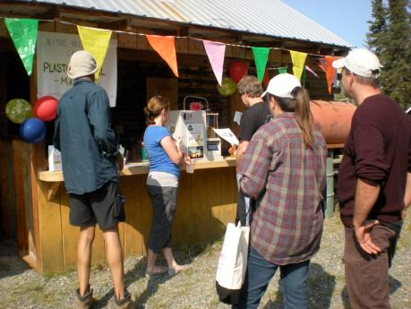
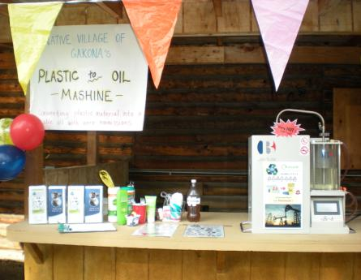
Kenny Lake Fair Demonstration
Interested crowd at the Fall Fair in Kenny Lake

Slide 9
Native Village of Kluti-Kaah Demonstration
Crowd participating in Oil machine demo just before lunch

Slide 10
Native Village of Gulkana Demonstration
One of the very first demonstrations in June 2012

Slide 11
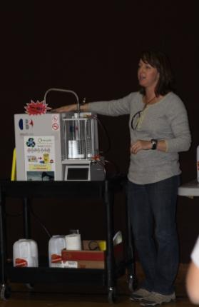
2012 Youth Environmental Summit
Several demonstrations were held at the YES event, which theme was based on Alternative Energy and Going Green.

Slide 12
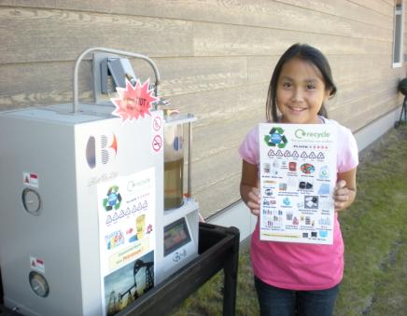
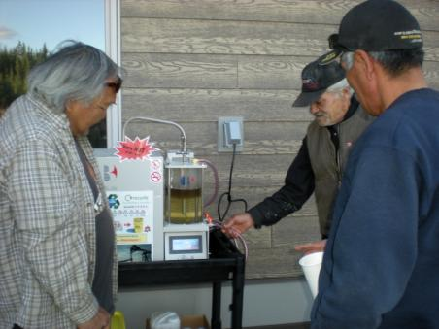
Native Village of Gakona Involvment
The community took active roles in processing oil within our village. It sparked a lot of interest of all generations!

Slide 13
The Process: Plastic Basics
Allowable plastics are #2, 4, 5, 6

Slide 14
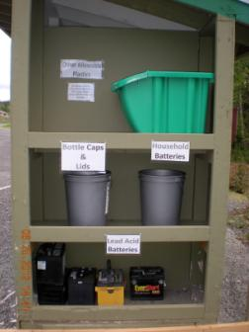
The Process: Collection
Recycling Center for All materials in Gakona Village

Slide 15
The Process: Visual Aid
Gas Tube
Anti-
Countercurrent
Valve
The lid of the
Liquefying Pot
Liquefying Pot
A Water Tank
Oil Release Valve
Operating Screen

Slide 16
The Process: Video

Slide 17
The Process: Video

Slide 18
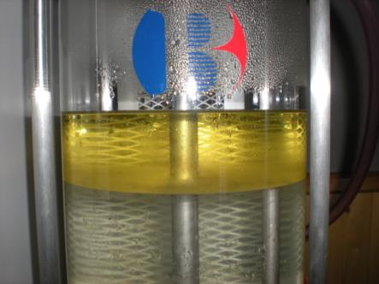
The Process: The Break Down
On average, the refined oil is made up of:
15-20% Gasoline
20-30% Kerosene
20-30% Diesel oil
The remainder is a “heavy oil”

Slide 19
The Process: Specifications
Be-H Machine (Desktop)
Processing Ability | ~1.5-2.2 lbs.
Percentage of making oil | More than 80%
Size of the machine | 22 (W) x 12.6 (D) x 21.3 (H)
Weight | Approx. 115 lbs.
Power Supply | 120V/14A
Running Cost | 1KW/hour, 2.5 hr to produce 1 quart of oil

Slide 20
The Results: Plastic Conversion
Amount of Plastic (lbs.) into Oil (pints)

Slide 21
The Results: Energy Costs
The machine on average runs 1KW/hour
$.27/Kw through Copper Valley Electric Association
Depending on how much plastic is loaded, machine runs 2.5-3.5 hours, averaging $1.08 per session
NVG totaled 52.7 lbs=28.3 quarts (7.07 gallons)= running cost $24.49

Slide 22
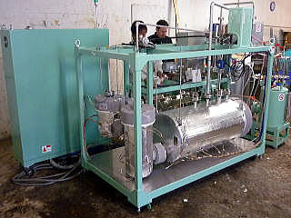
The Future: Moving Forward
Native Village of Gakona is in the planning phase of research for the large scale machine: NVG 200
440 lb per day (24-hr)
Continuous
Approx: 55 gal. / day
Cost: $189,333.33

